Slide 1
CityGML 3.0 WP03 Use Cases
Thomas H. Kolbe, Andreas Donaubauer, Kanishk Chaturvedi
Chair of Geoinformatics
Technische Universität München
kutzner@tum.de
28 July, 2014
CityGML 3.0 WP 03 Web Conference

Slide 2
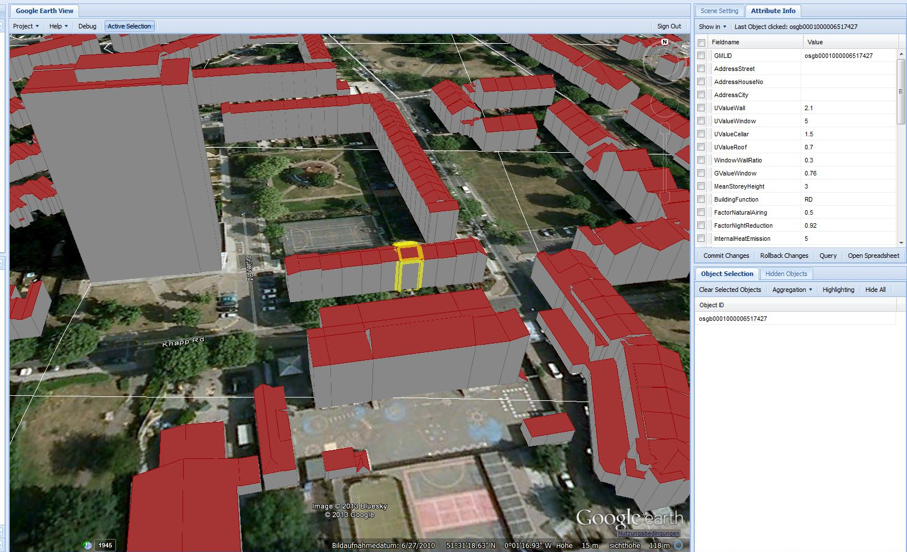
Uses Case: Energy Demand Calculation – Example: London
Building A, Apartment 1:
storey: 0
numberOfRooms: 4
numberOfInhabitants: 2
Building A, Apartment 2:
storey: 1
numberOfRooms: 4
numberOfInhabitants: 4
Building A, Apartment 3:
storey: 2
numberOfRooms: 2
numberOfInhabitants: 1

Slide 3
Uses Case: Energy Demand Calculation – Example: London
Outer shell of building is required for:
Calculating building volume
Calculating surface area of outer shell (includes calculation of shared wall surfaces between buildings)
Discriminating different types of boundary surfaces (RoofSurface, WallSurface, GroundSurface). LOD2 boundary surfaces are used (LOD3 would be more appropriate but is not available for City- or district-wide simulations)
Building Interior: one object per apartment, no geometry but relevant thematic information
Requirements for LOD concept:
Combining information on building interior - In this case “apartment objects” (→ requirement for WP 13) – with LOD2 outer shell

Slide 4
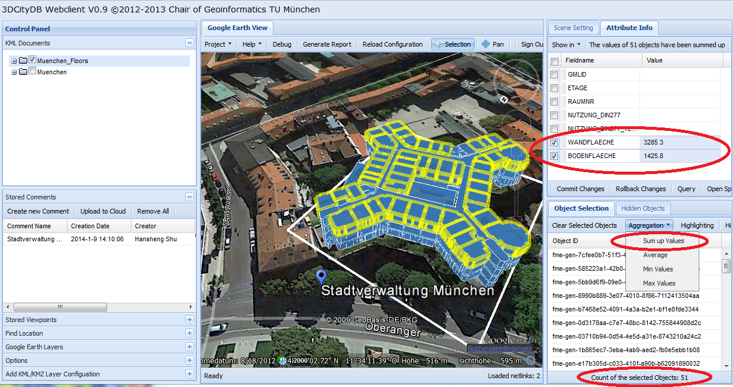
Uses Case: Computer Aided Facility Management – Example: City of Munich

Slide 5
Uses Case: Computer Aided Facility Management – Example: City of Munich
Rooms:
were generated by extrusion from 2D CAD
carry detailed semantic information coming from CAFM system
Boundary surfaces of Rooms are semantically classified (InteriorWallSurfaces, CeilingSurfaces, FloorSurfaces) in order to attach semantic information coming from CAFM system
Outer shell of building is available only in LOD2
Requirements for LOD concept:
Represent Rooms with generalized geometry (“LOD1”)
Represent interior boundary surfaces without openings (“LOD1 CeilingSurface”)
Combination of an LOD2 outer building shell with “LOD1”-Rooms

Slide 6
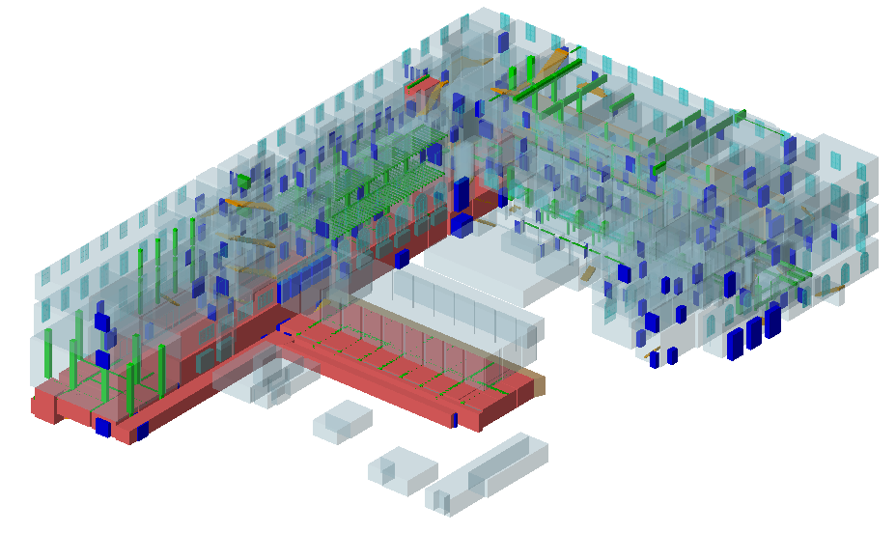
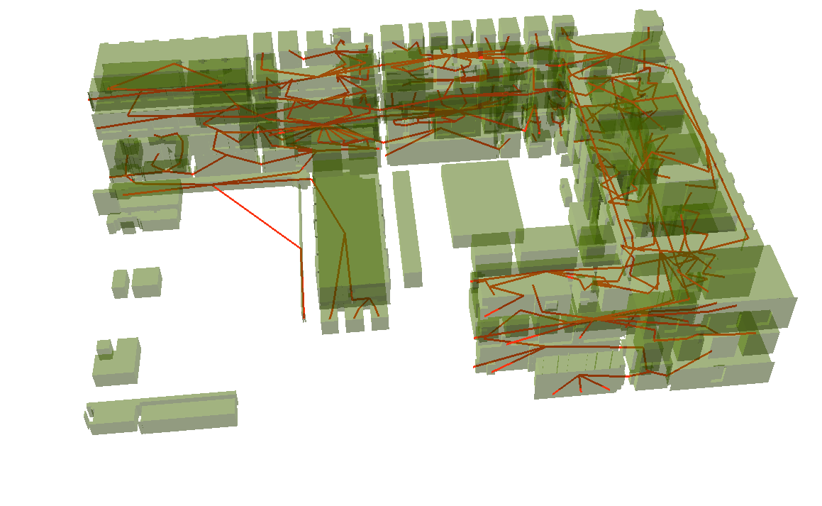
Uses Case: Subspacing of Indoor Space for Creating Indoor Routing Graphs

Slide 7
Uses Case: Subspacing of Indoor Space for Creating Indoor Routing Graphs
CityGML Rooms and InteriorBuildingInstallation are used for automatic subspacing and routing graph extraction for different locomotion types (walking, driving, flying) → Transformation to IndoorGML
Detailed representation is required for:
Rooms including Openings
InteriorBuildingInstallation
Building object and possibly BuildingPart objects are required but outer Shell of Building is not required
Requirements for LOD concept:
Represent Building objects without an outer shell
Combining LOD4 Rooms with those Building objects

